Slide 1

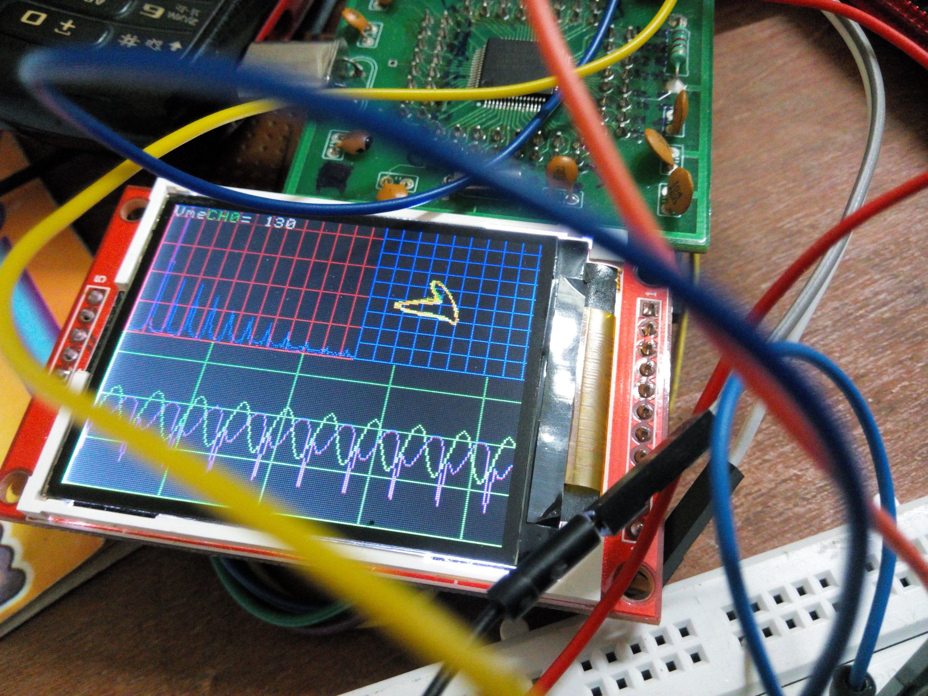
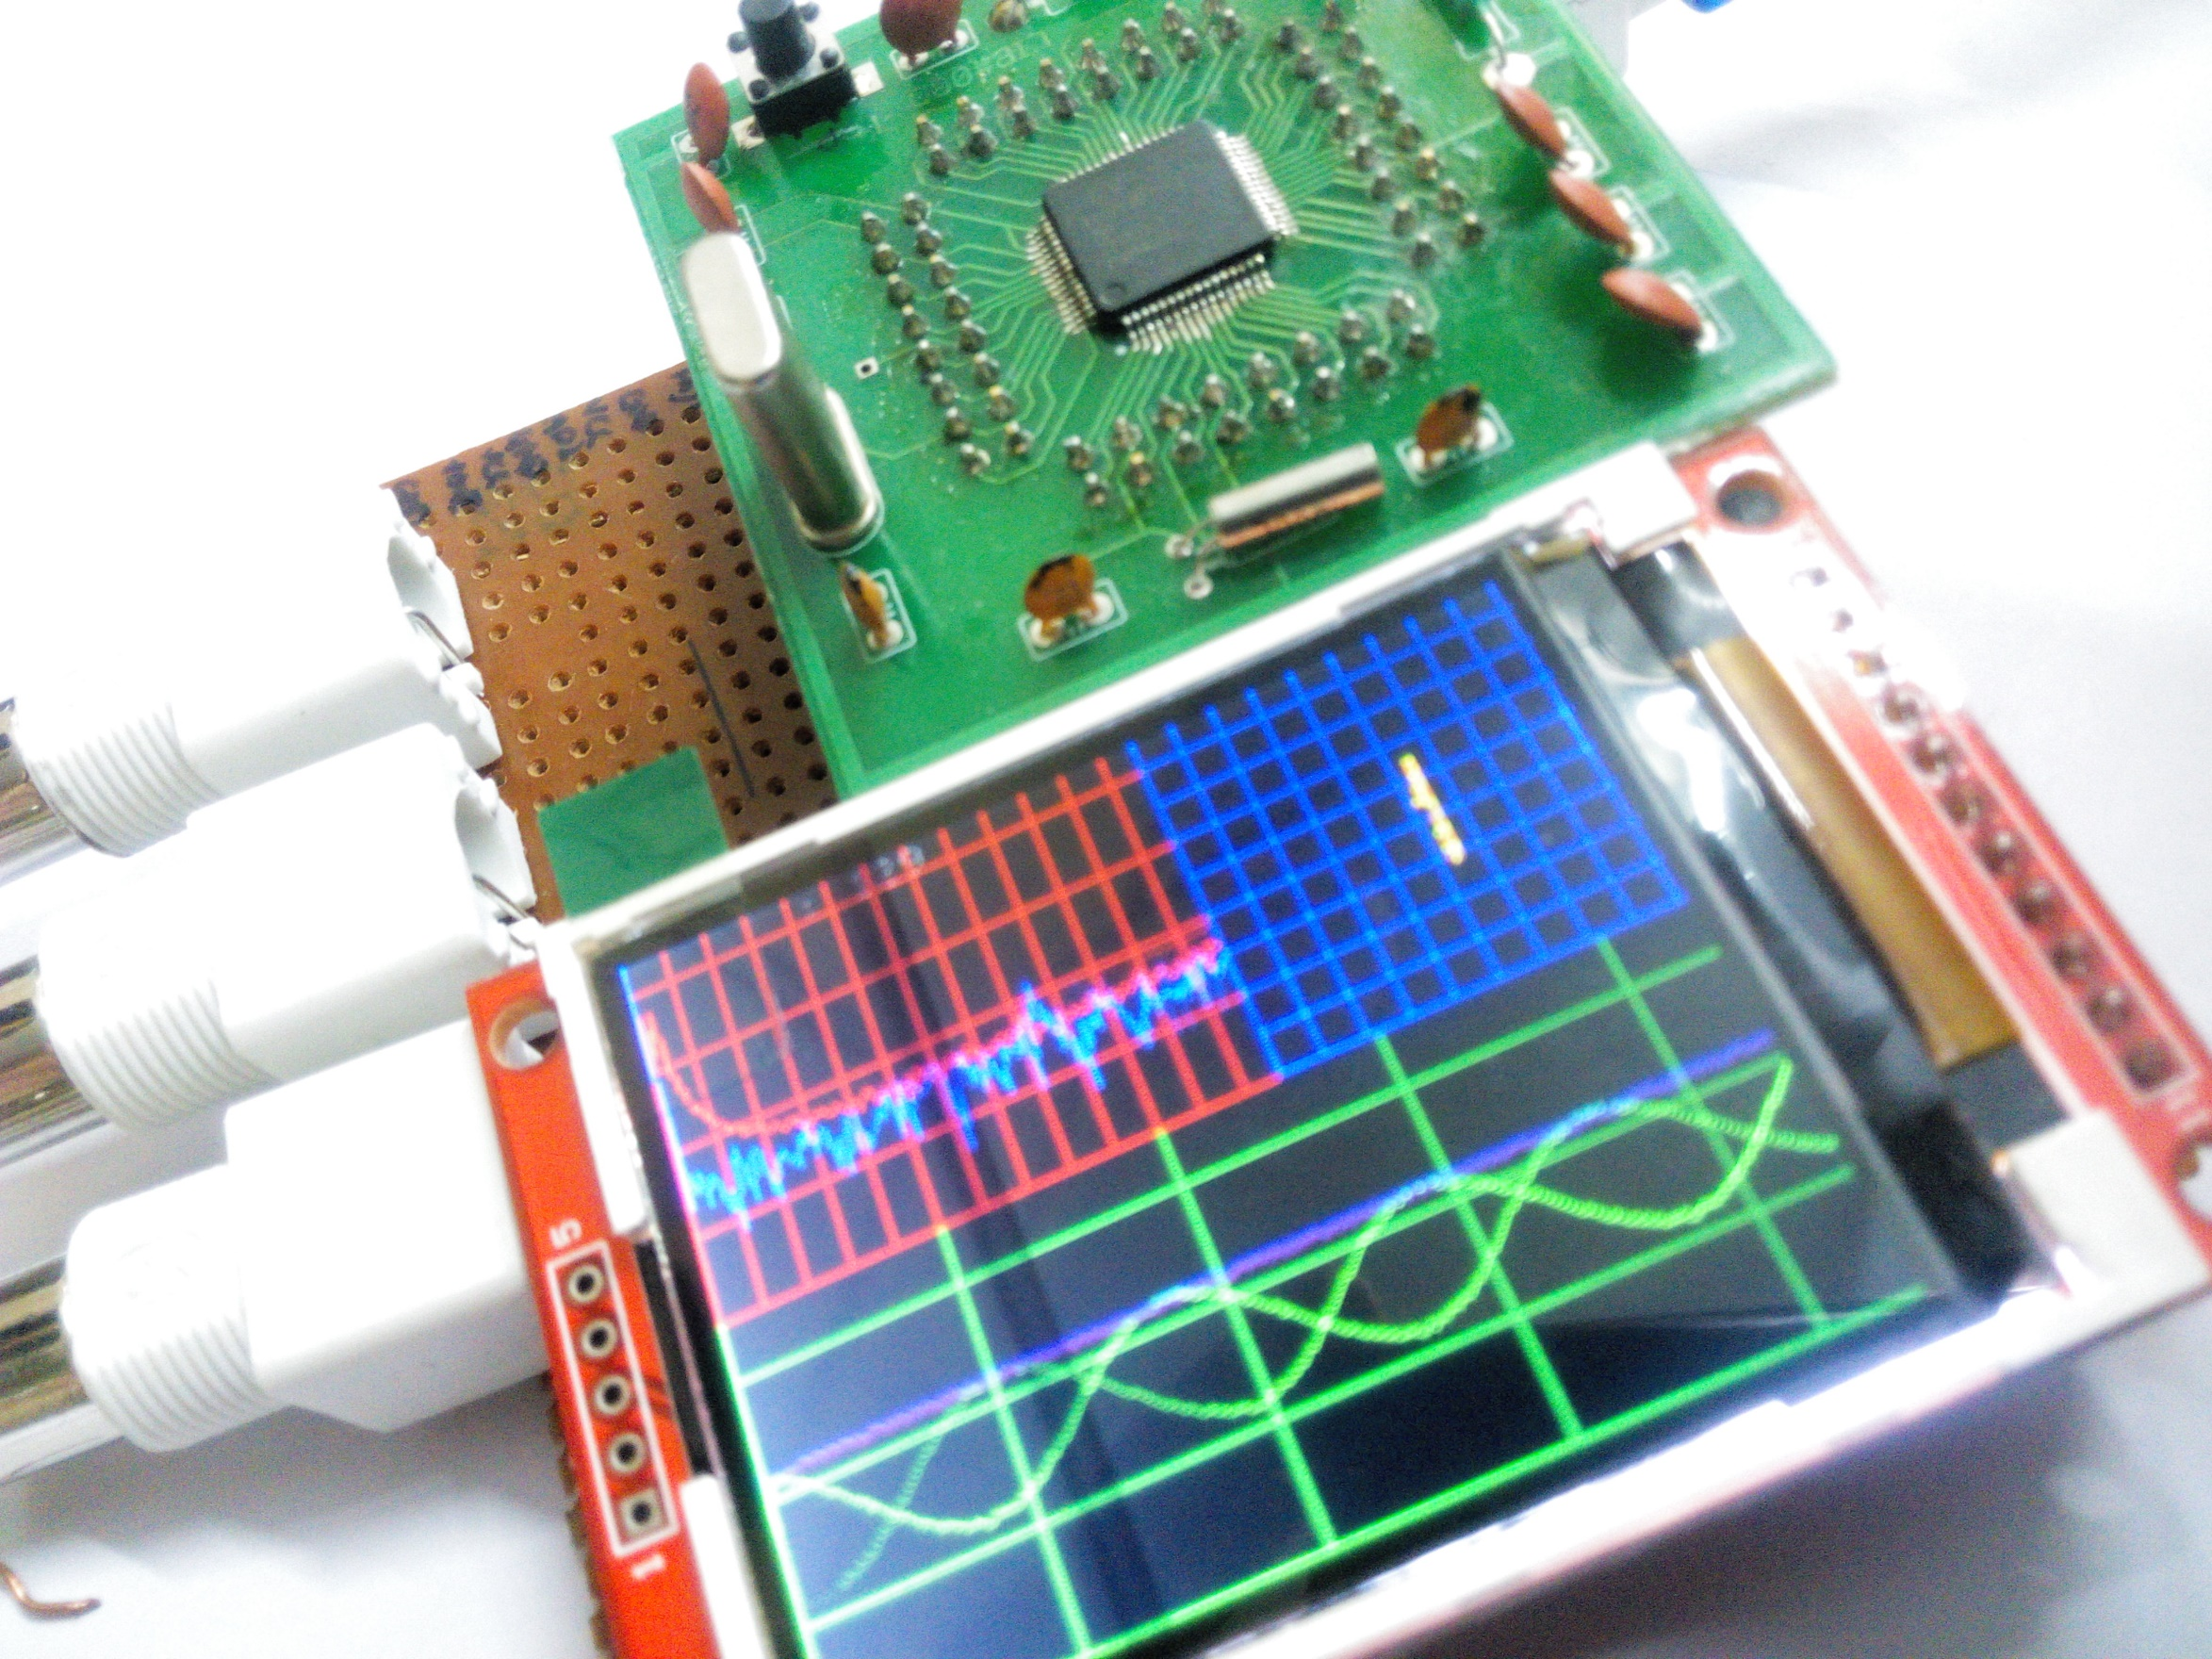
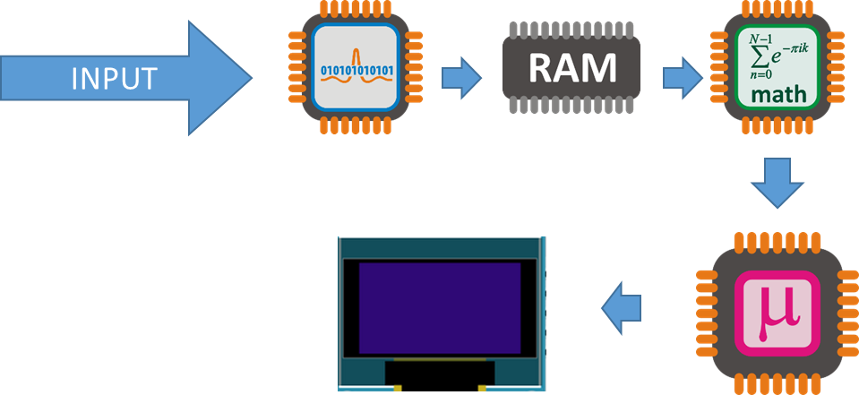
Digital Oscilloscope …Electrical Engineer’s Stethoscope
Ajinkya Gorad , 2nd year undergrad (Electrical Engineering) , IIT Bombay
Objective
Timelines
Creating a cheap & small oscilloscope for student use.
Prototype 0
Signal Acquisition & Display ( LCD display optimization)
Spectrum
Processing on Raw data (FFT) for Spectrum
Optimization
Making it pretty and optimizing for faster refresh rate
X-Y plot
Adding X-Y Plot without compromising much of performance
Specifications
Dual Channel simultaneous measurement with function generator
Battery Powered design
Displays Waveform, Spectrum, and X-Y Plot simultaneously captured with 10 bit accuracy ADC (Analog to Digital Converter)
Software adjustible parameters
sampling frequency and voltage grid
Type of window for Fast Fourier Transform (FFT)
type of Spectrum plot ( linear or log)
Software predefined function generator with internal DAC (Digital to Analog Converter)
Input buffering to avoid damage to the oscilloscope
BLOCK DIAGRAM
Include results based on your experiments
Result 2
Result 3
Future Ideas
Adding Knobs for Controlling Sampling rate and Zooming in the waveform for more flexible control
Including on board storage and USB connection for data logging
Adding flexible input circuitry
Design on PCB to reduce further cost and size
Some internal Details
Software
Internal Dual ADC 10 bit
These are kept the same throughout your experiments
Independent variable
The one variable you purposely change and test
Dependent variable
The measure of change observed because of independent variable
Decide how you will measure the change
Software written in embedded C++ on ARM7 LPC21xx processor family with OOP (Object Oriented Programming)
Following are some of the specs
60MHz Operation
3.3 V operation and current consumption of __ in normal use
Resources
FFT algorithm http://staff.science.nus.edu.sg/~phywjs/CZ5101/fft.c written by Wang Jian-Sheng.
Project source at https://github.com/ajinkyagorad/LPC_2148_OSCLLOSCOPE
Contact Mail : ajinkyagorad@gmail.com

